Slide 1
Problem Statement
Problem: Employee attrition refers to the process where employees leave an organization either voluntarily or involuntarily. High attrition rates can be problematic for companies as they result in increased costs related to recruitment, onboarding, and training, as well as a loss of organizational knowledge and morale
Solution: The solution lies in using data analysis and machine learning models to predict which employees are likely to leave the organization based on various factors like job satisfaction, compensation, work-life balance, tenure, performance, and other demographic variables.
Our Main Objectives include:-
Predict Employee Attrition
Identify Key Drivers of Attrition
Provide Actionable Insights
Improve Retention Strategies
Reduce Attrition Costs

Slide 2
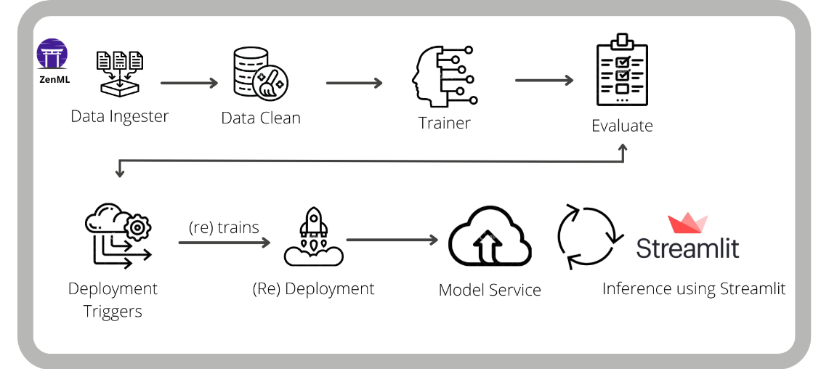
Architecture(Block Diagram)

Slide 3
Predicts employee attrition (who will leave or stay) based on historical data, helping HR to take proactive retention measures.
Attrition Prediction Model (Implementation Completed)
Functionalities:
Predicts Employee attrition (who will leave or stay) based on historical data, helping HR to take proactive measures.
Input Given:
Employee data such as demographics, job satisfaction, compensation, performance, and tenure.
Results Obtained:
Predicted likelihood of attrition (attrition risk score), insight on key factors influencing attrition (e.g. job satisfaction , salary ) and actionable recommendations for HR.
Execution:
Preprocess data (Handles missing values , encode categorical variables)
Train a machine learning model ( e.g. Logistic Regression)
Evaluate model performance using metrics like accuracy and F1 score.
Predict attrition and actionable insights to HR for retention strategies.

Slide 4
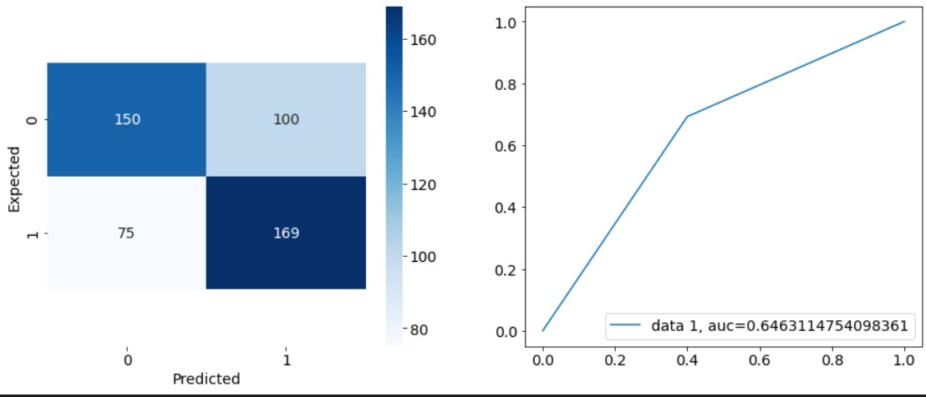

Slide 5
Models for ZenML Pipeline (Implementation Completed)
Functionalities:
The ZenML pipeline automates the process of training, evaluating, and deploying a machine learning model for employee attrition prediction. It manages and tracks the entire workflow, ensuring reproducibility, scalability, and versioning of data, models, and outputs.
Input Given:
Employee data ( features like demographics, job satisfaction, salary etc).
Labels ( whether an employee left or stayed).
Results Obtained:
Predictions: A list of predicted values (attrition or retention) for each employee.
Metrics: Evaluation results such as accuracy , precision, recall , and F1 score for model performance.
Execution:
Model Training: Train a machine learning model using preprocessed data.

Slide 6
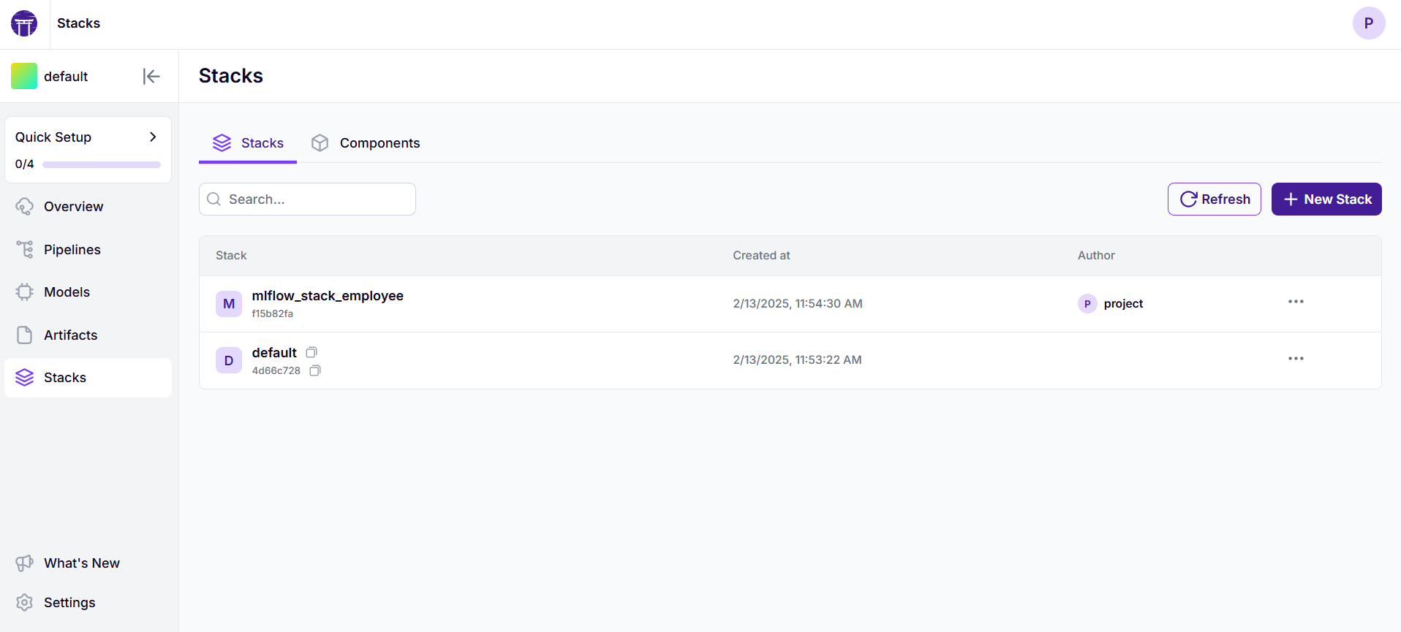

Slide 7
Streamlit Model (Implementation Completed)
Functionalities:
The Streamlit app allows users to input employee data, and it predicts whether the employee is likely to leave the company (attrition = 1) or stay (attrition = 0) based on a pre-trained model.
Input Given:
Age: Employee Age (numeric input)
Salary: Employee’s salary (numeric input)
Job satisfaction: Job satisfaction level
Results Obtained:
A prediction displayed as 0 ( the employee is likely to leave the company) or 1 (the employee is likely to stay with the company).
Execution:
The pre-trained model makes a prediction.
The prediction result is displayed on streamlit interface.

Slide 8
